Slide 1
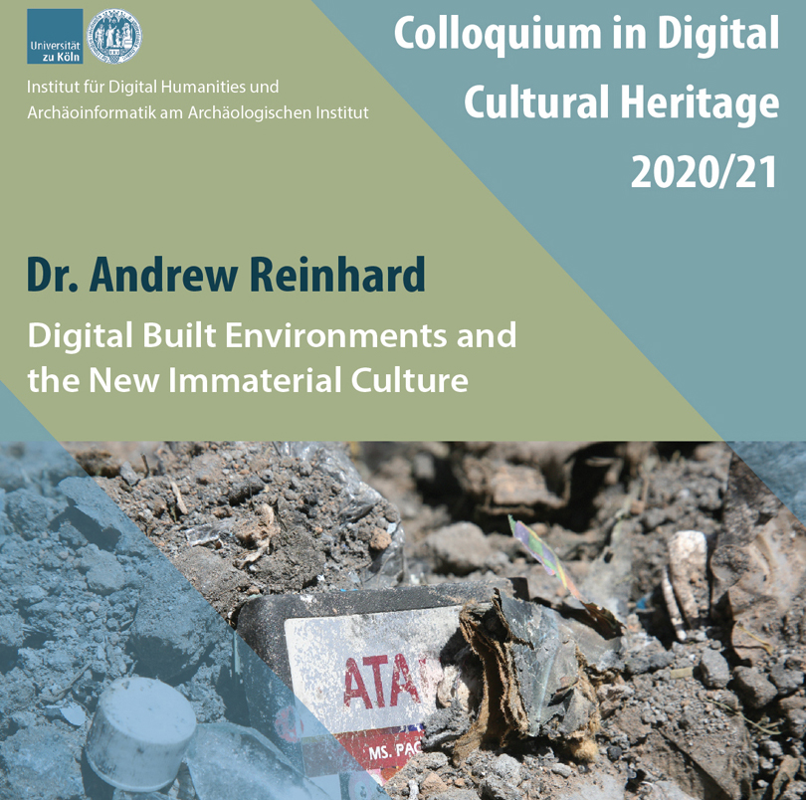

Slide 2
EVAPORATION
OF THE ARCHAEOLOGICAL RECORD
Notes:
Let’s think back to those first series of slides I showed you. In each case, the technology affects your behavior, and when enough people are affected, it either changes a culture or creates a new culture.

Slide 3
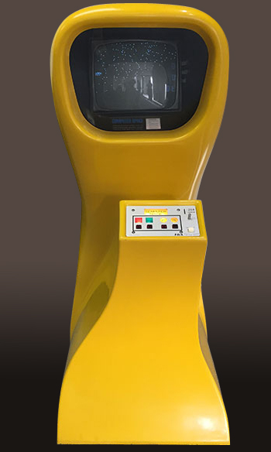
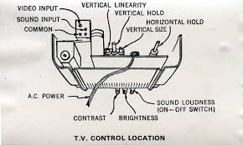
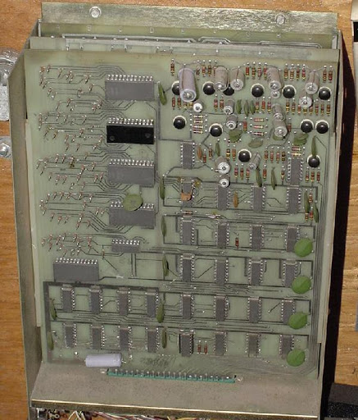

Slide 4
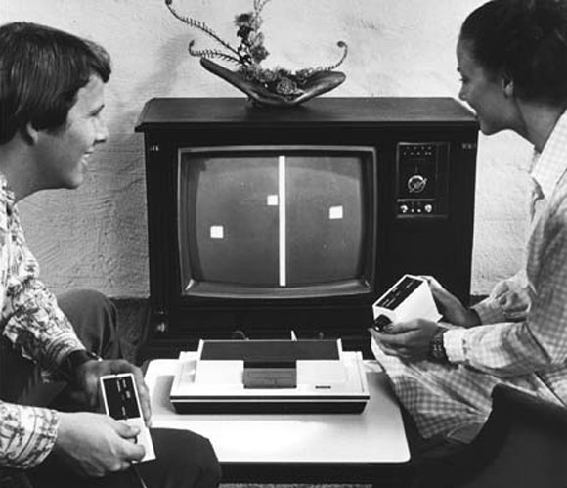

Slide 5
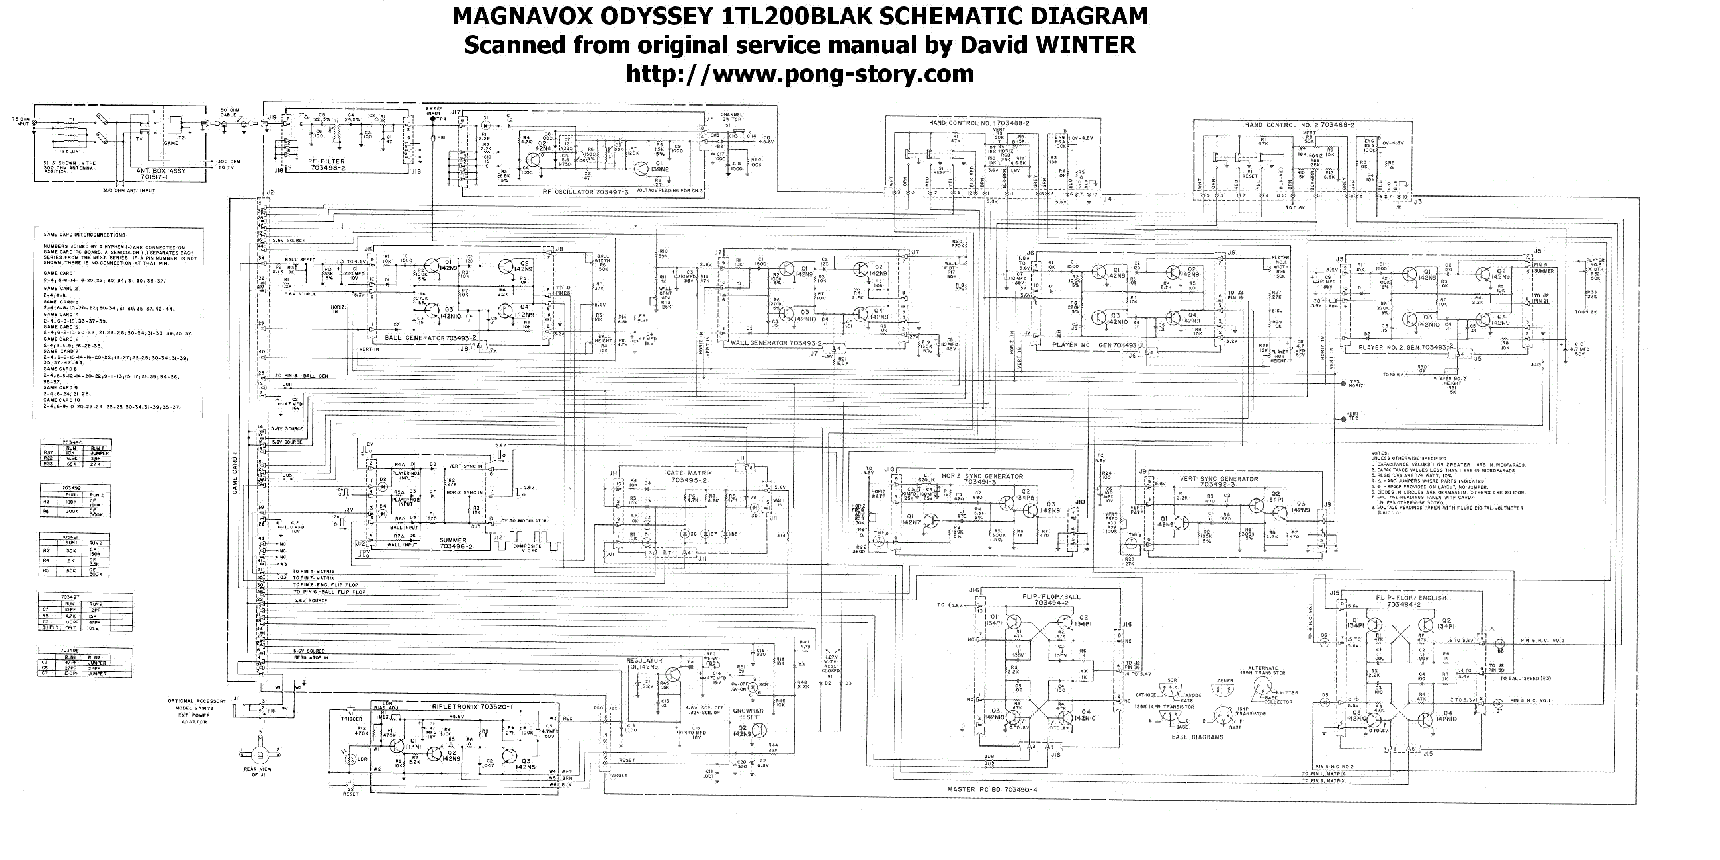

Slide 6
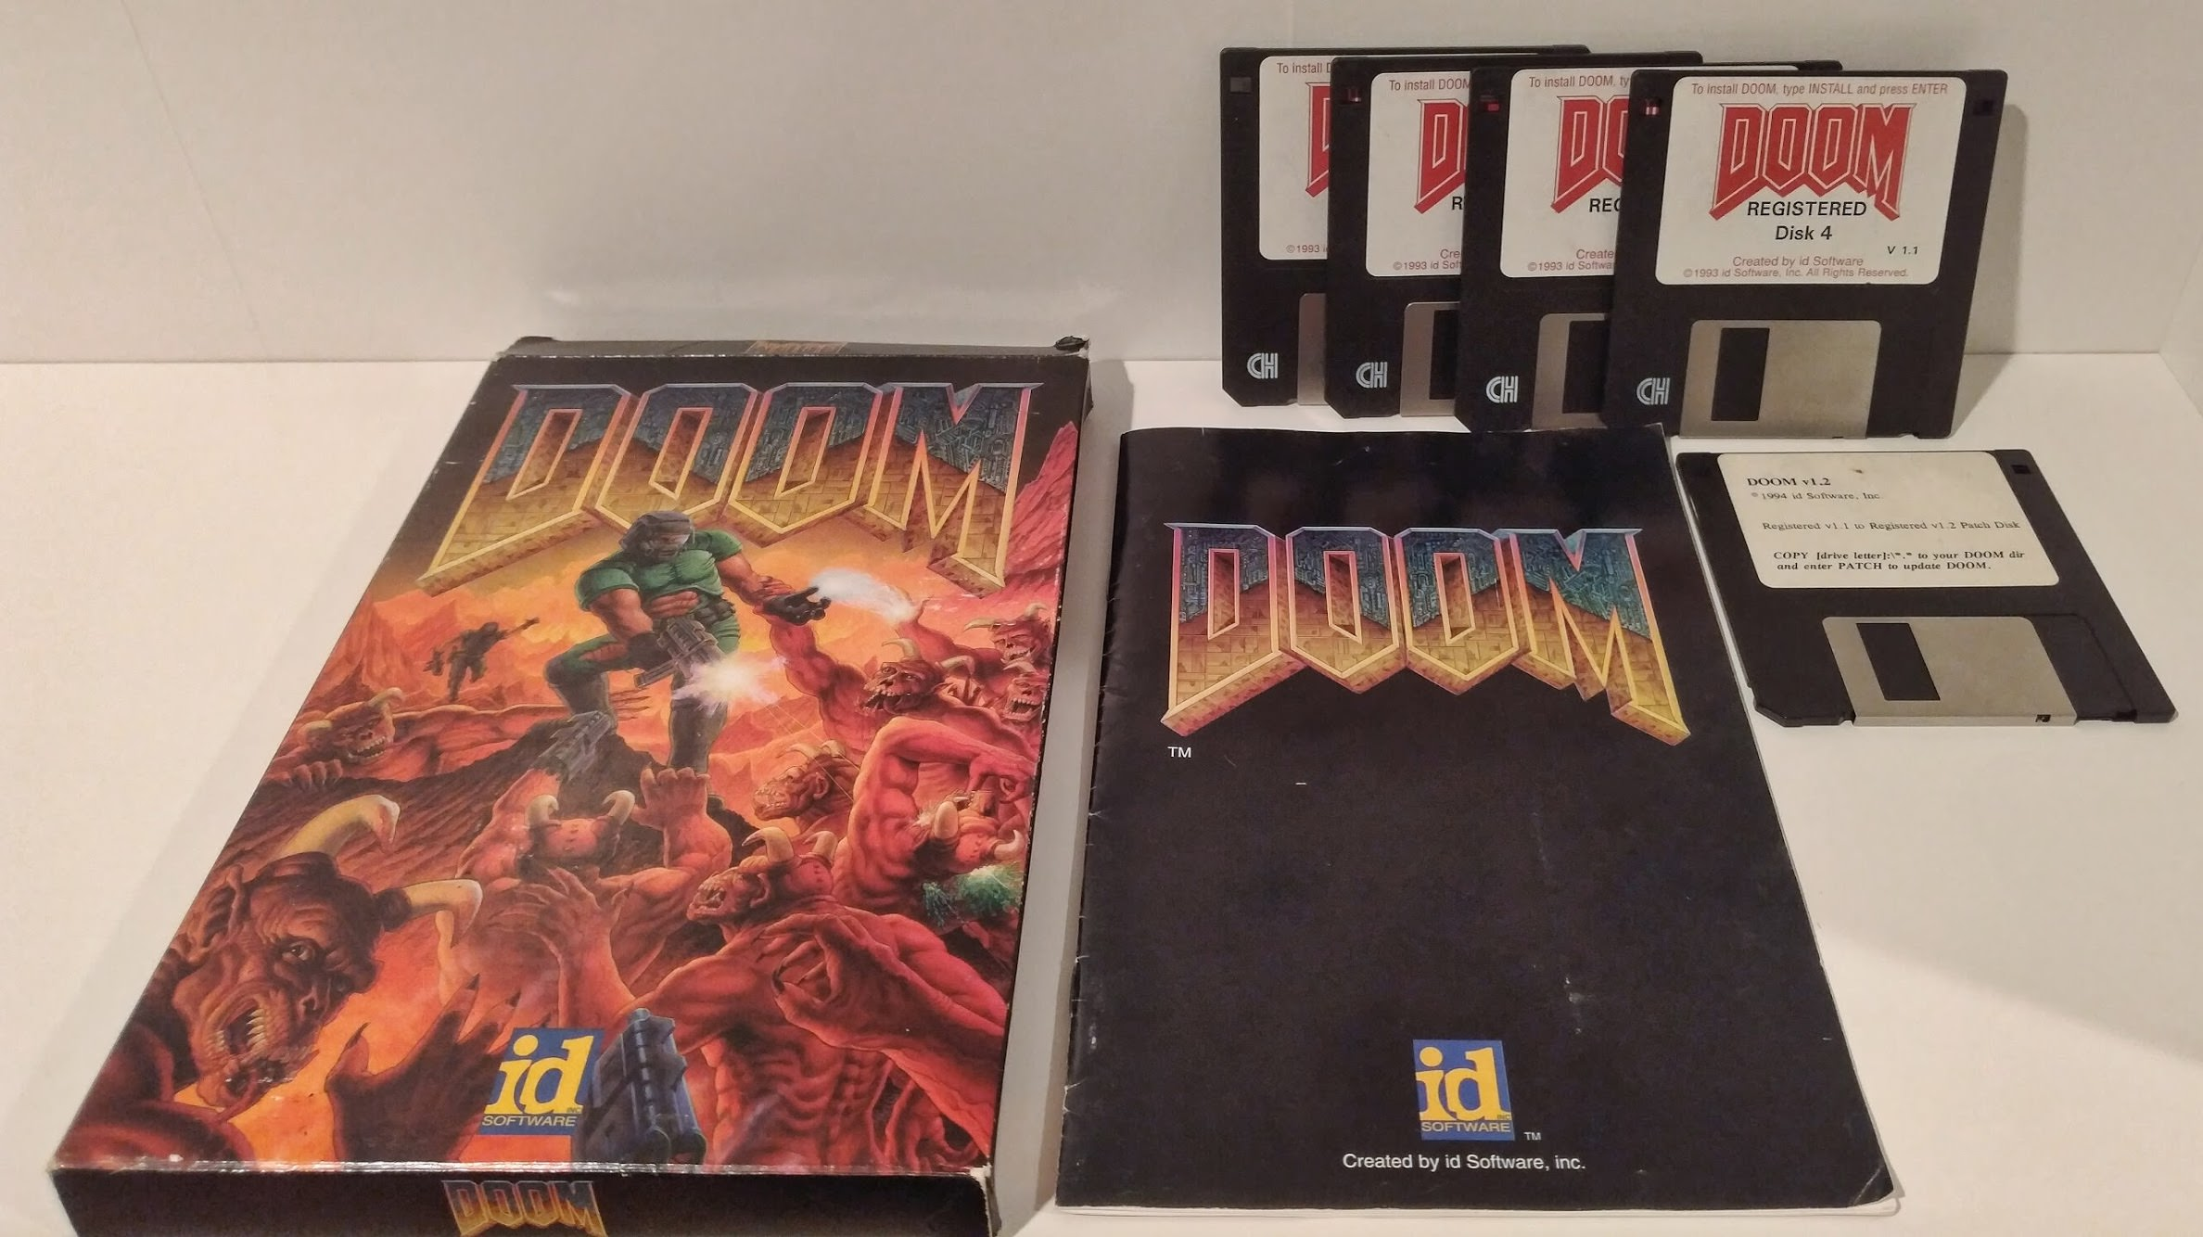
1993

Slide 7
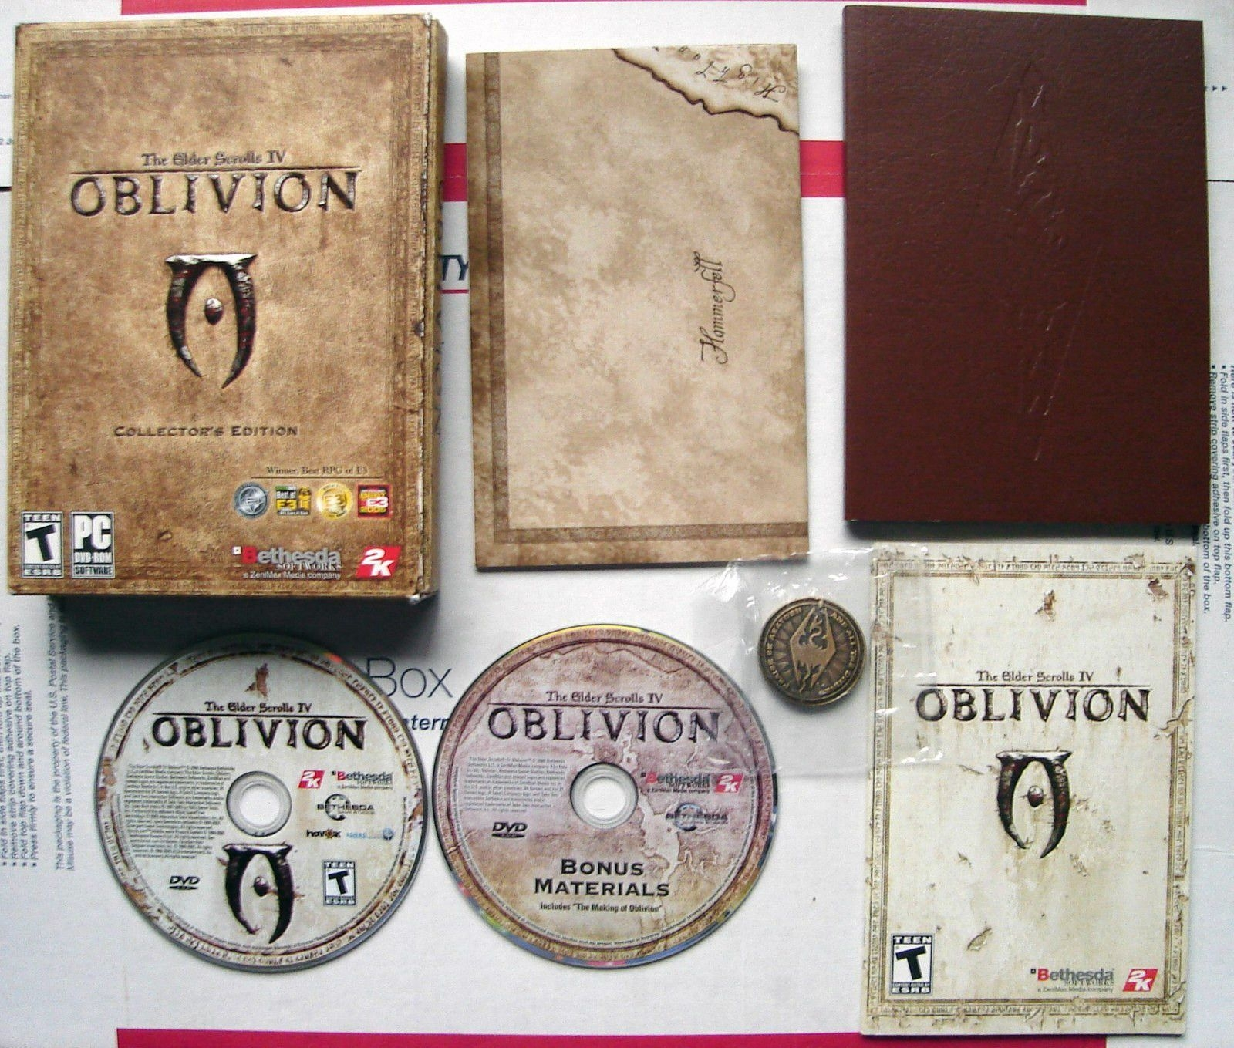
2
0
0
6

Slide 8
2016

Slide 9
2012

Slide 10
2016

Slide 11
2019

Slide 12
(IM)MATERIAL ARCHAEOGLOGY
Notes:
Let’s think back to those first series of slides I showed you. In each case, the technology affects your behavior, and when enough people are affected, it either changes a culture or creates a new culture.

Slide 13
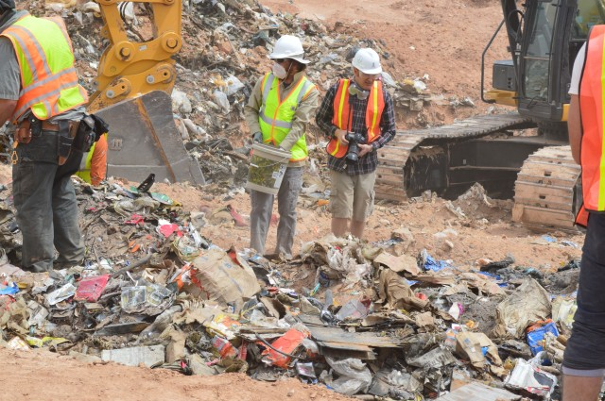

Slide 14
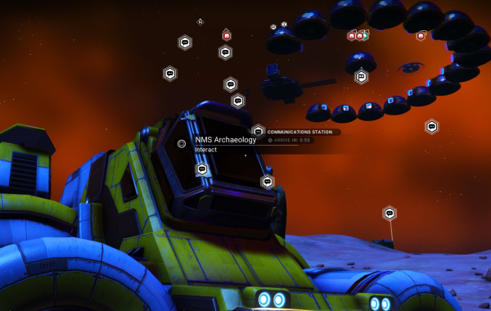

Slide 15
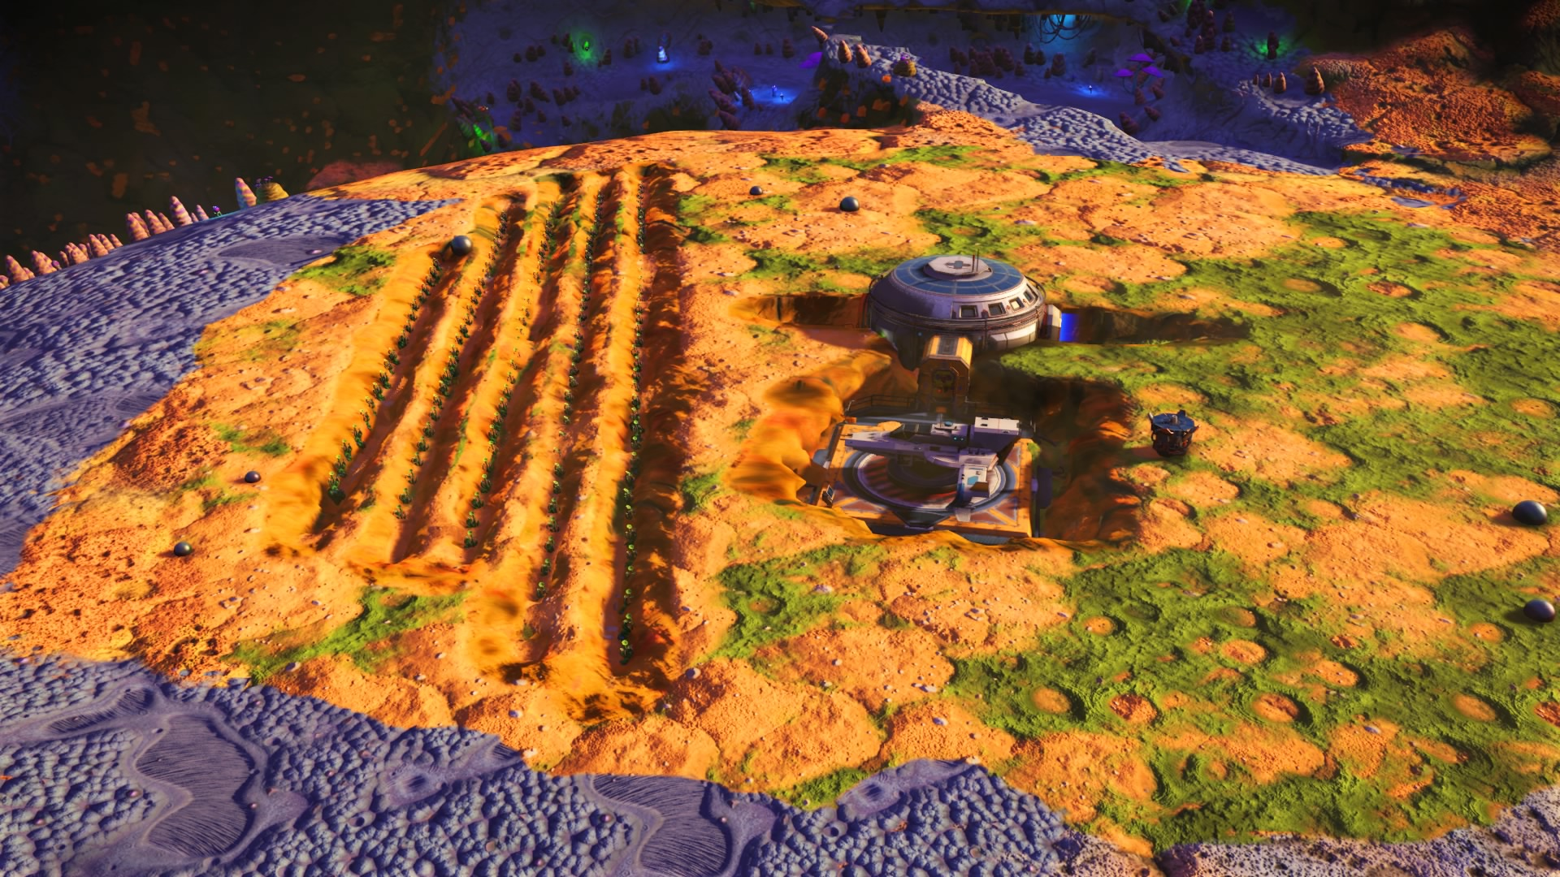
Notes:
Because games such as this one, No Man’s Sky, can be settled by human players, I though that I could conduct human archaeology in digital places. I was not disappointed. I excavated this site.

Slide 16
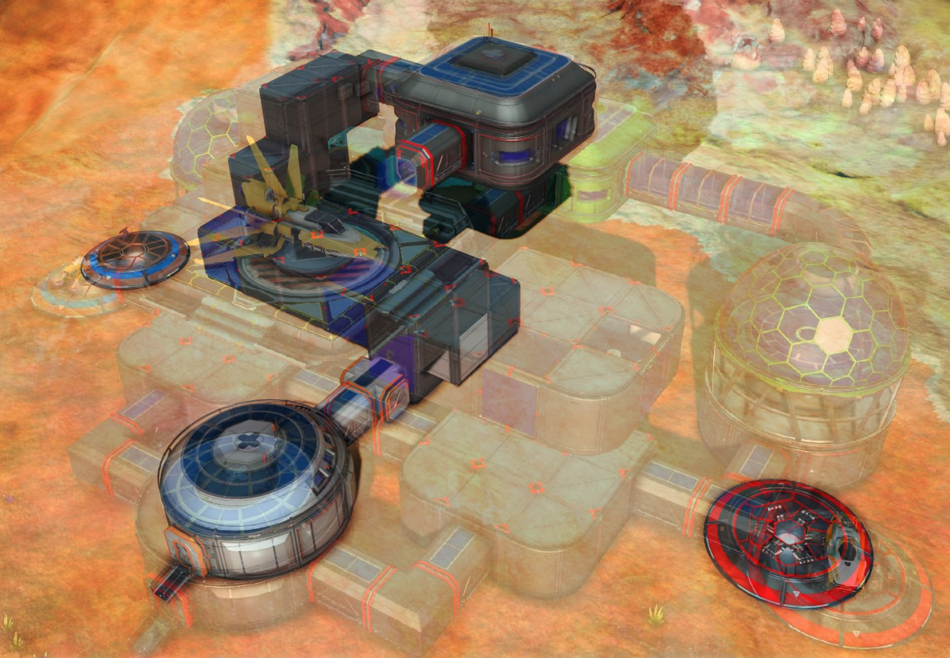
Notes:
I used photogrammetry to match archival photos with new photos of how abandoned settlements in the game appear now.

Slide 17
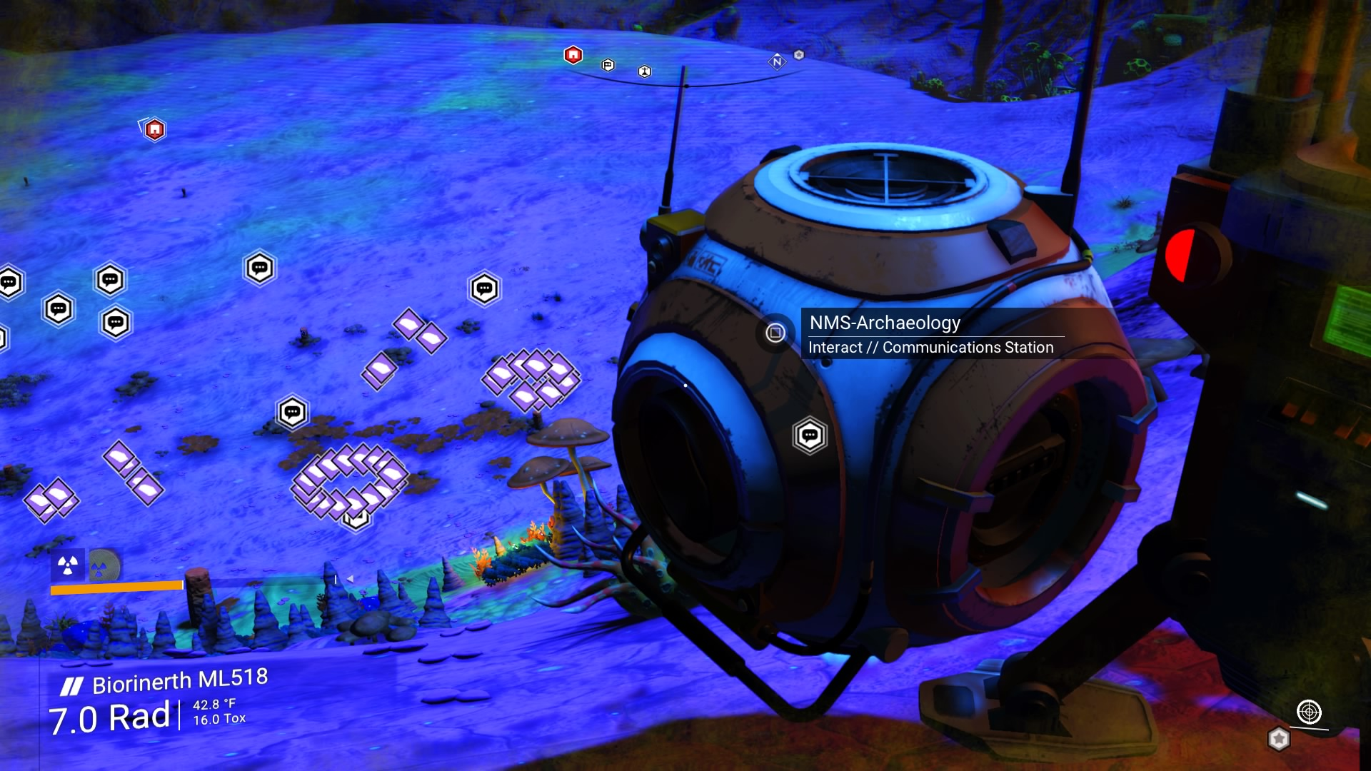
Notes:
I used remote sensing to find footprints of human-made buildings buried as an unintended consequence of a software update.

Slide 18
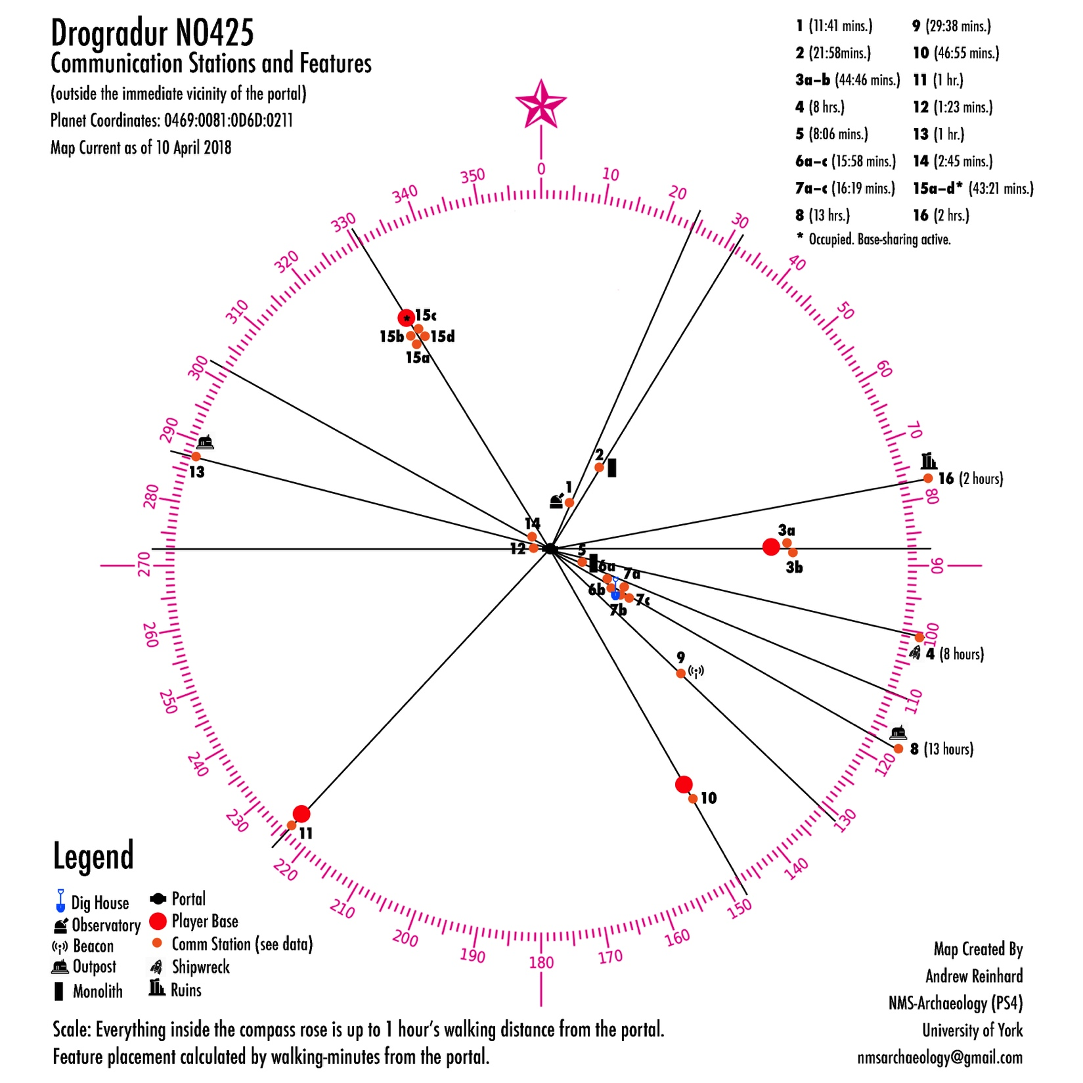
Notes:
I was able to create a new kind of mapping system for permanent places created in game spaces lacking any kind of GPS coordinates.

Slide 20
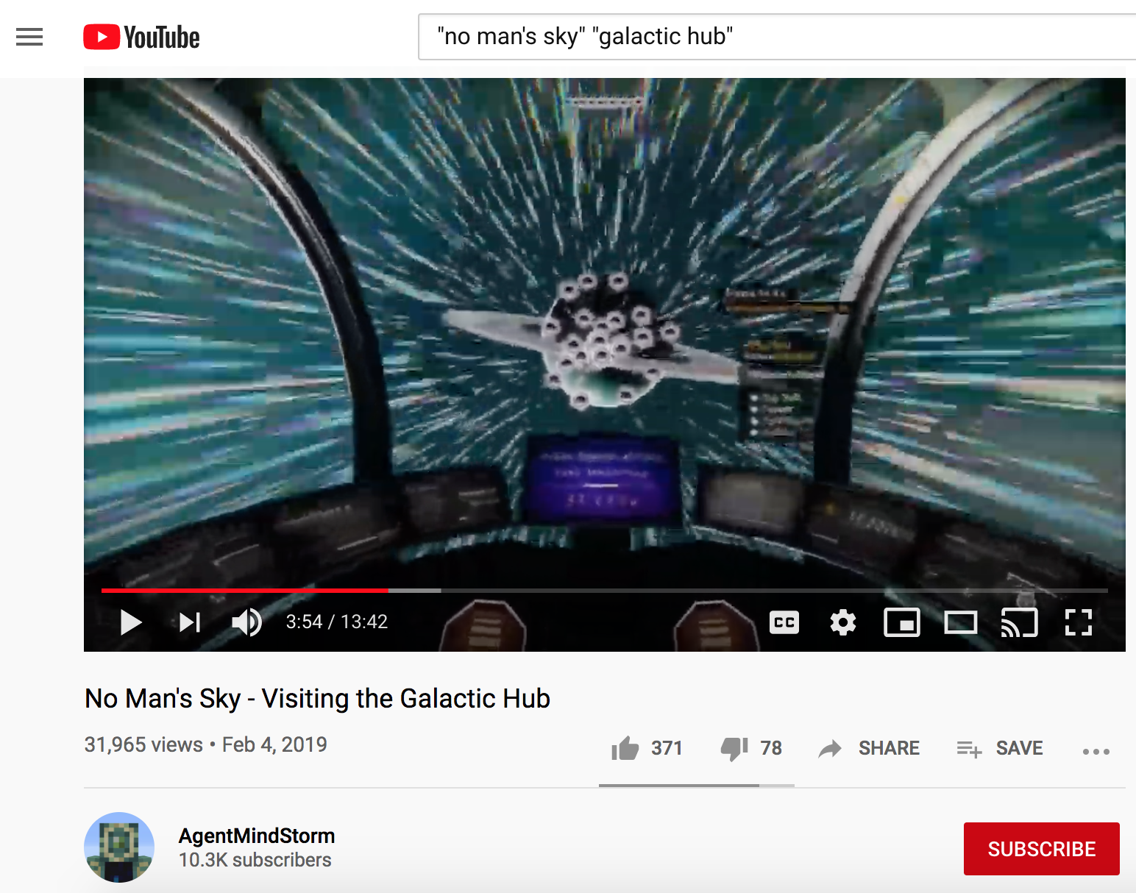

Slide 21
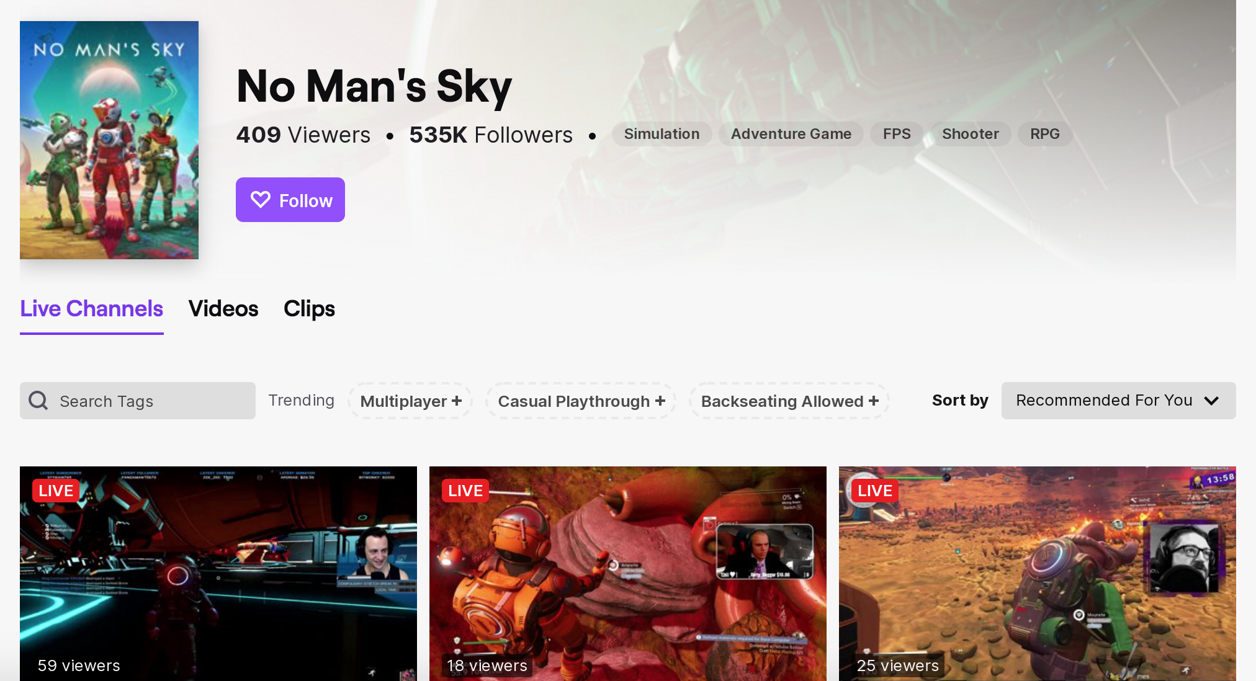

Slide 22
Notes:
In Skyrim VR, I was able to do another kind of photogrammetry, extracting 3D artifacts presented on 2D screens…

Slide 23
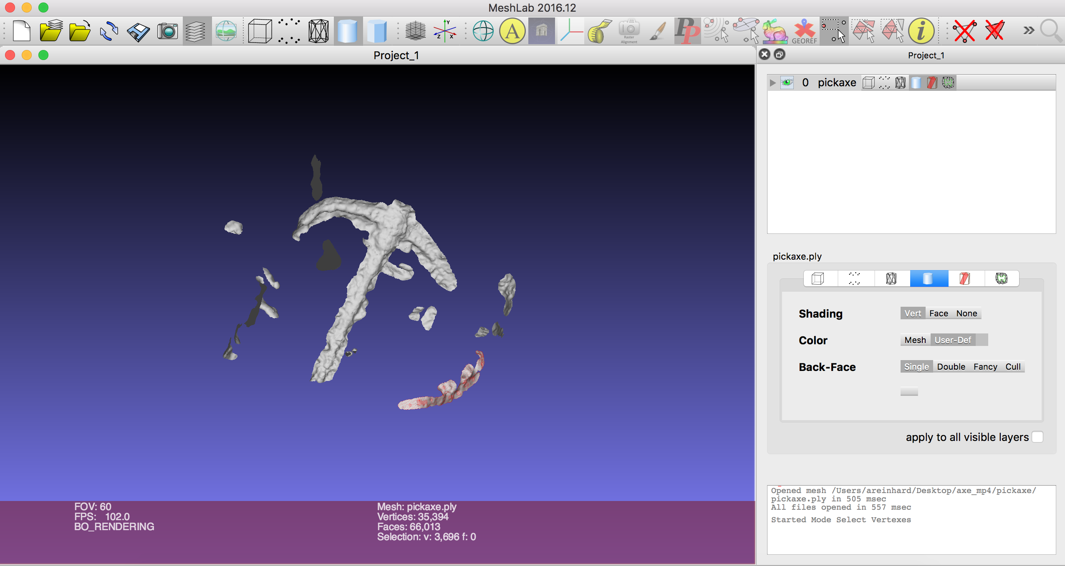
Notes:
…converting them to meshes, which can be 3D printed, bringing imagined digital artifacts into the natural world.

Slide 24
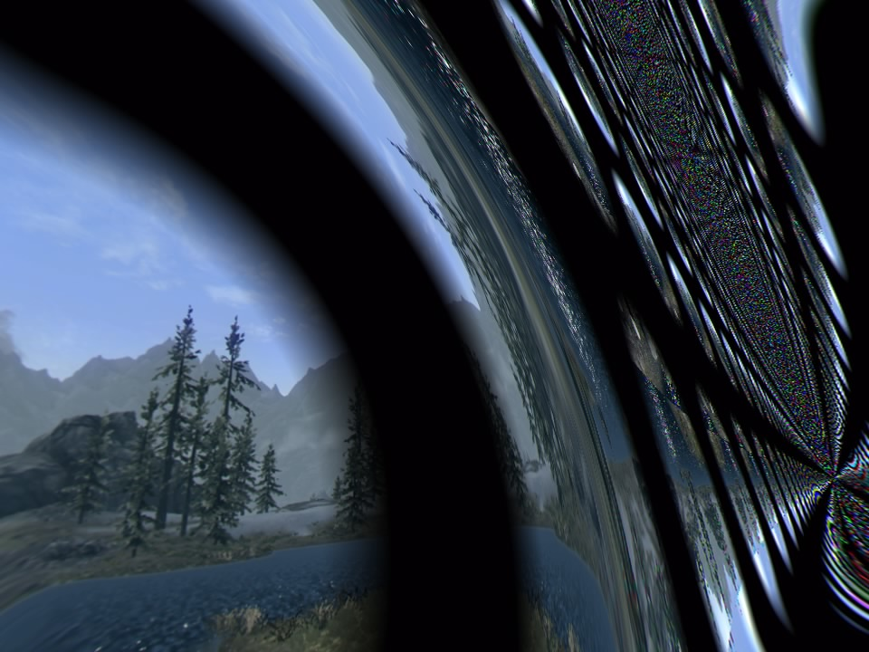
Notes:
I found glitch-artifacts, which would disappear once patched by the developer.

Slide 25
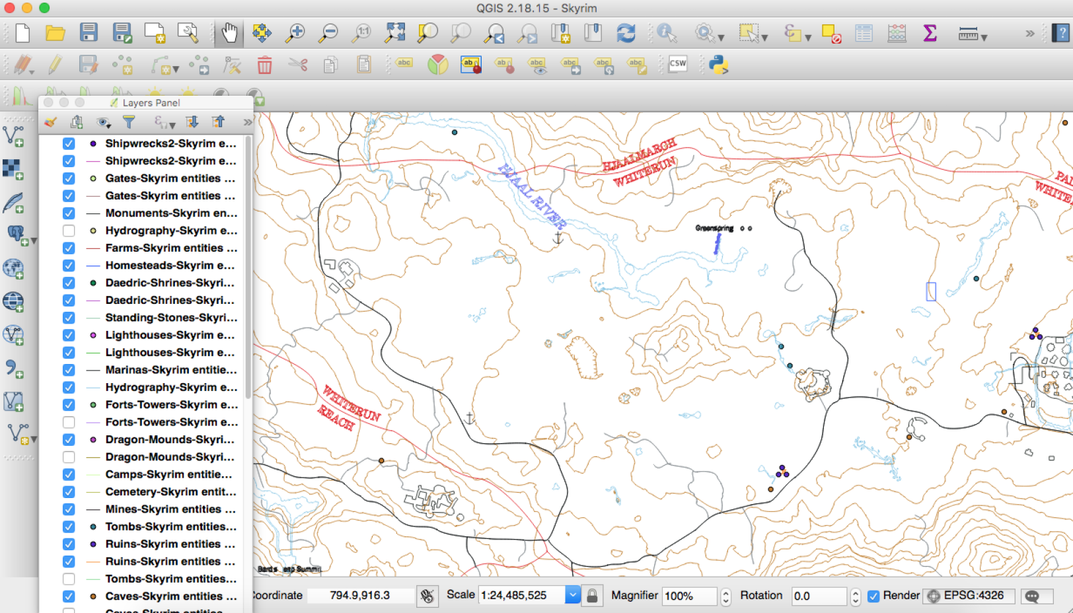
Notes:
I used QGIS to create layered maps of a region in Skyrim, in this case the Rorikstead Valley.

Slide 26
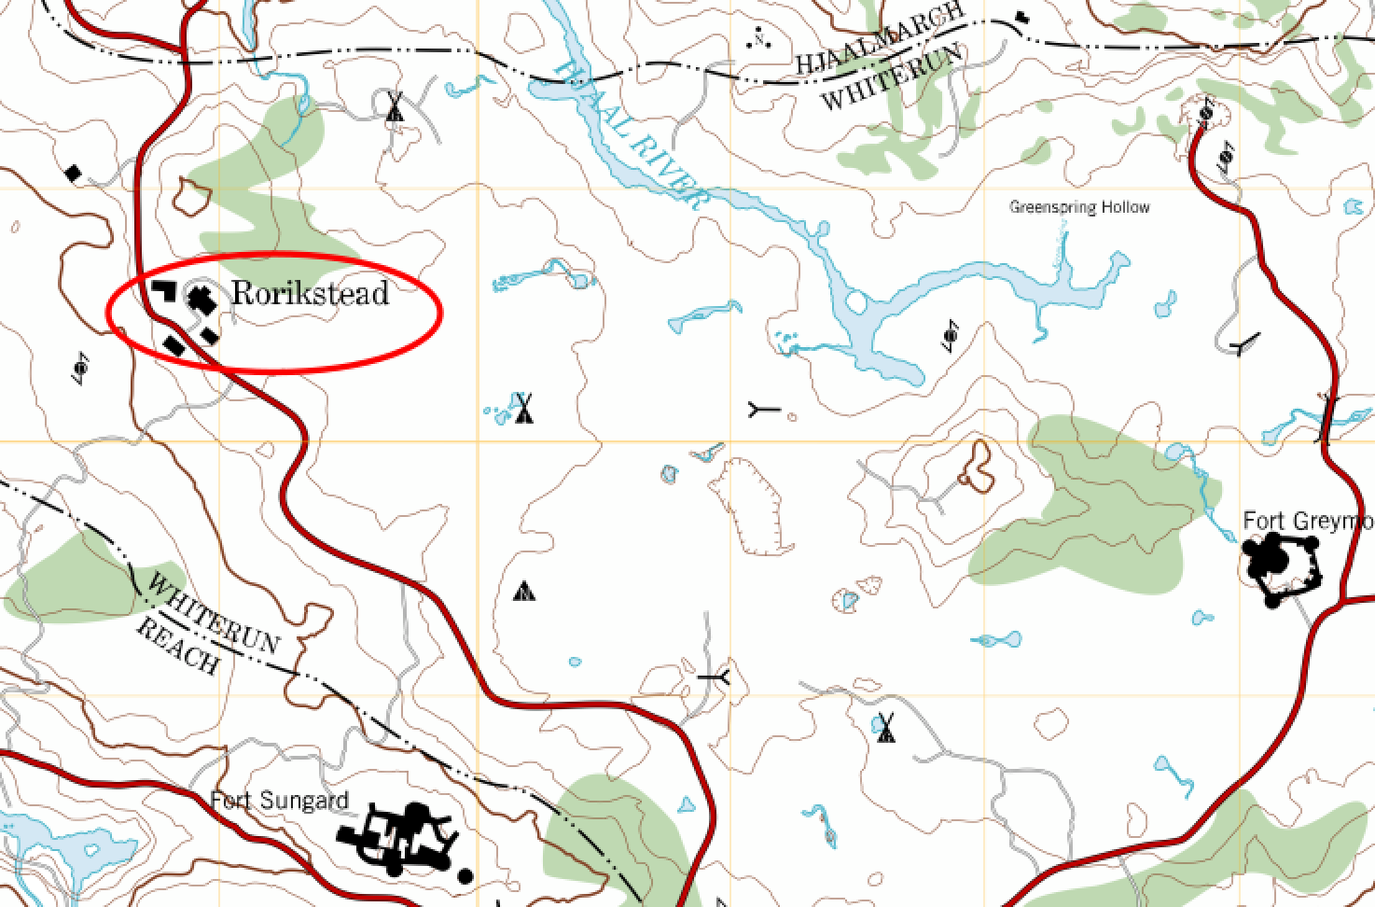
Notes:
Let’s think back to those first series of slides I showed you. In each case, the technology affects your behavior, and when enough people are affected, it either changes a culture or creates a new culture.

Slide 27
NOSTALGIA
Notes:
Let’s think back to those first series of slides I showed you. In each case, the technology affects your behavior, and when enough people are affected, it either changes a culture or creates a new culture.

Slide 29
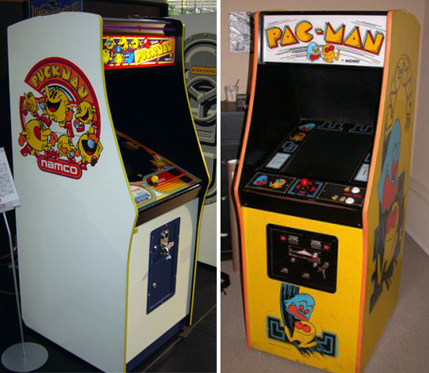

Slide 30
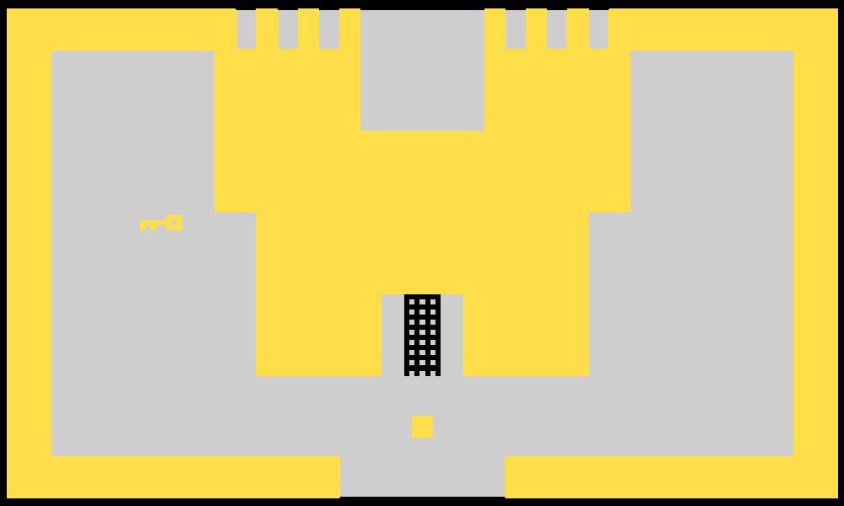

Slide 33
Universally recognized current console game/character?

Slide 36
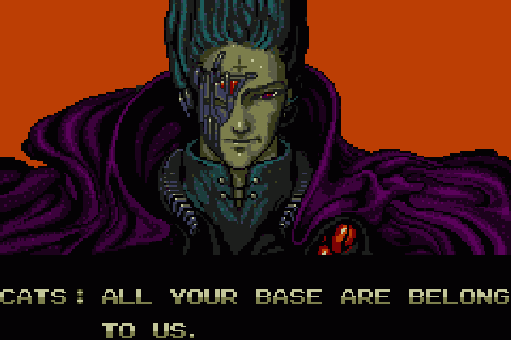

Slide 39
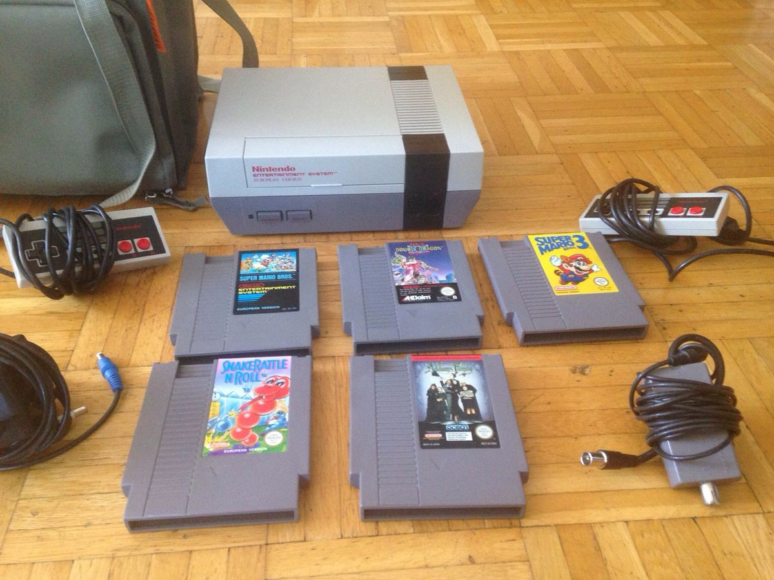

Slide 40
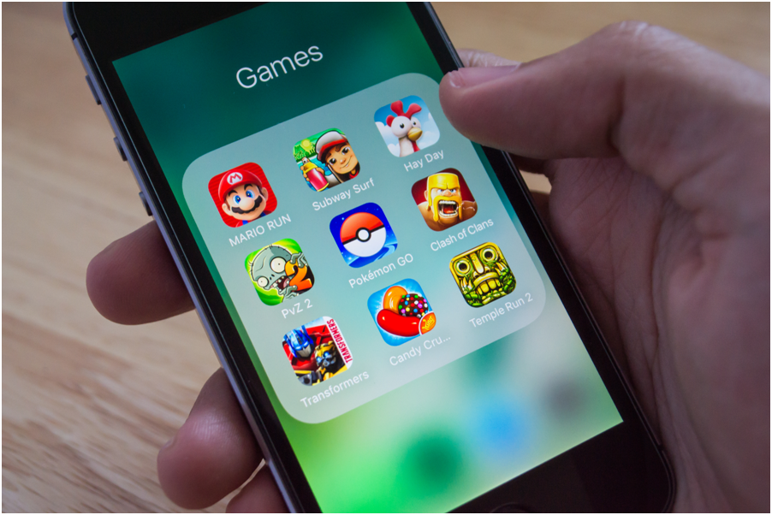
Material/emotional memory for games in 2020, specifically mobile games?

Slide 42
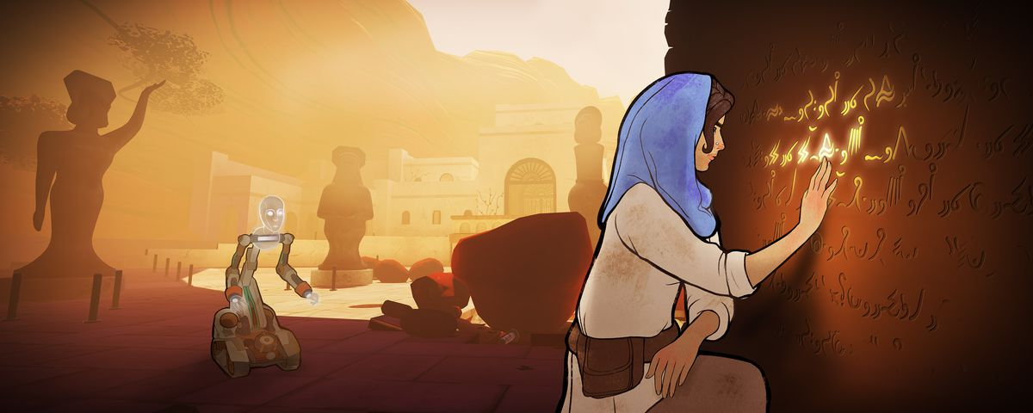

Slide 43
HUMAN CREATIVITY
Notes:
Let’s think back to those first series of slides I showed you. In each case, the technology affects your behavior, and when enough people are affected, it either changes a culture or creates a new culture.

Slide 44
Notes:
In Fallout 4 you can build settlements, and these can grow and change over time depending on how you intend to use the place. Players of this and other games can also build and modify in smaller environments such as houses.

Slide 45
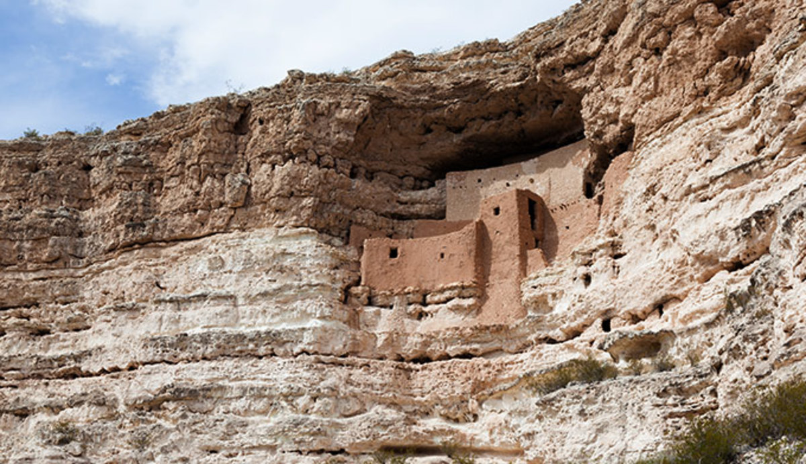
Notes:
Montezuma Castle National Monument, Arizona. People have always modified their environments and habitations.

Slide 46
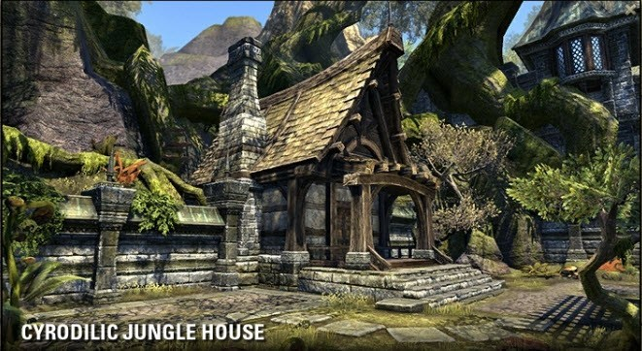
Notes:
In Elder Scrolls Online, players can build and decorate their homes within the digital landscape.

Slide 47
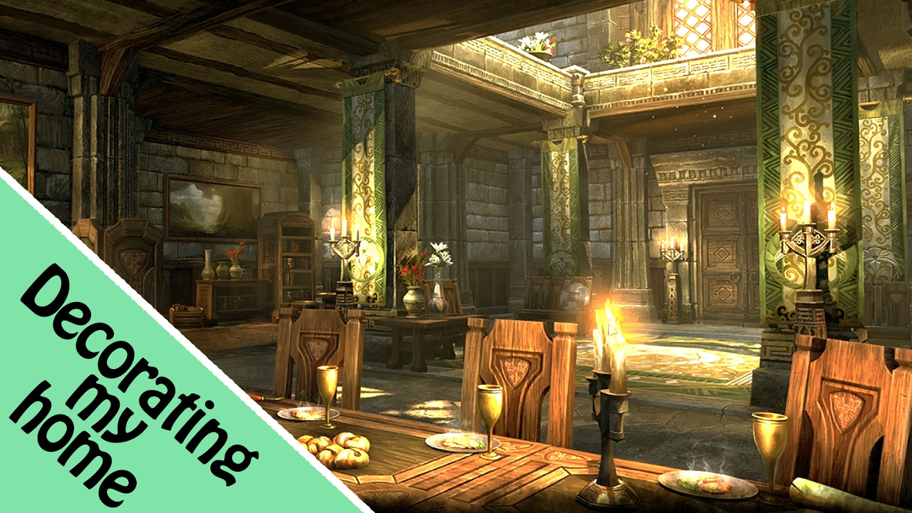
Notes:
ESO decorating guide.

Slide 48
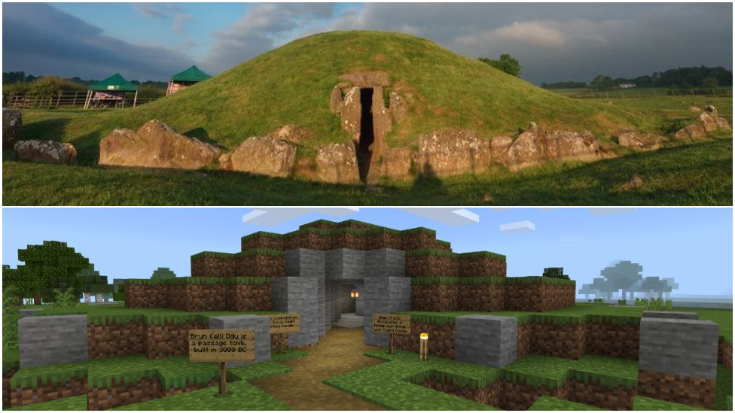

Slide 50
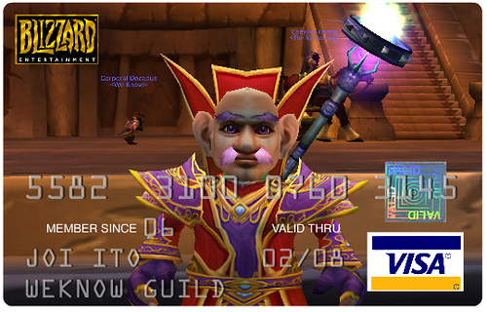

Slide 51
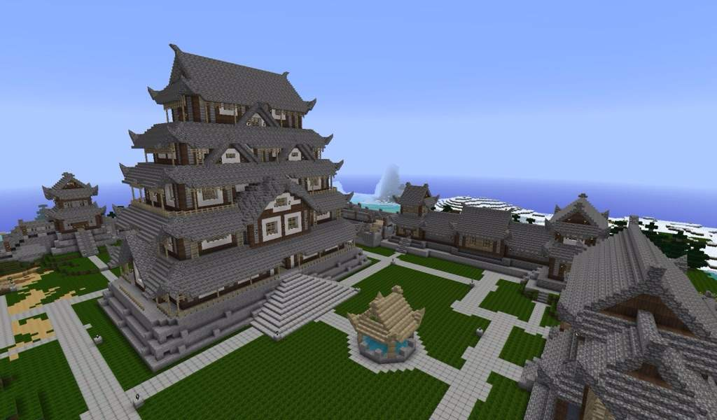

Slide 52
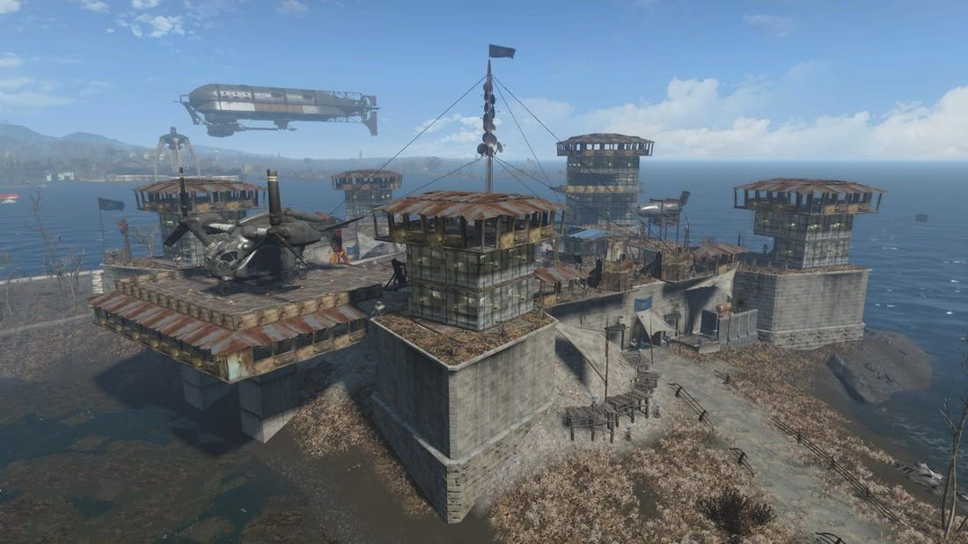

Slide 53
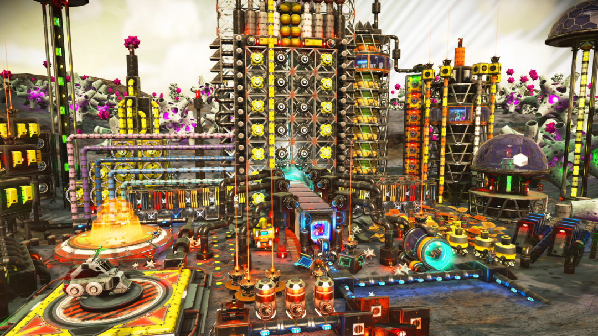

Slide 54
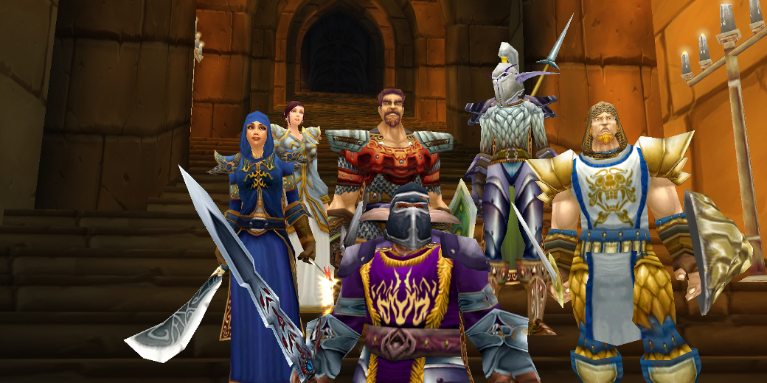

Slide 55
Archaeology is about things and people, but mostly people.

Slide 57
ARCHAEOLOGY OF THE DIGITAL
Notes:
Let’s think back to those first series of slides I showed you. In each case, the technology affects your behavior, and when enough people are affected, it either changes a culture or creates a new culture.

Slide 58
“We won’t experience 100 years of progress in the 21st century—it will be more like 20,000 years of progress (at today’s rate).”
—Ray Kurzweil (2001)

Slide 59
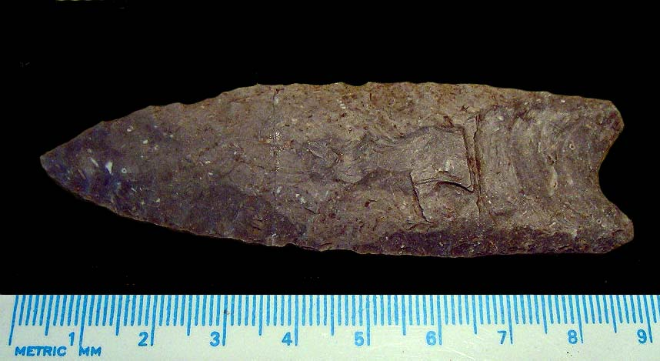
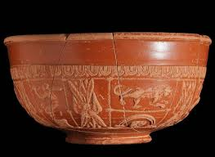
Clovis Culture – 13,000-11,000 BP
Terra sigillata – 1st c. BCE to 3rd c. CE

Slide 60
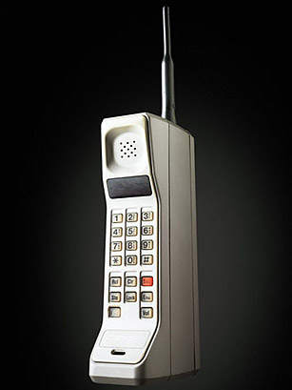
First commercially available mobile phone: 1983 (DynaTAC 8000x)
First iPhone: June 29, 2007
Now annual iPhones

Slide 61
First public video game cabinet: Computer Space, 1971
First public video game for home use: Pong 1972 (created by Atari founders)
First video game console: Magnavox Odyssey, 1972

Slide 62
1972

Slide 63
2018

Slide 64
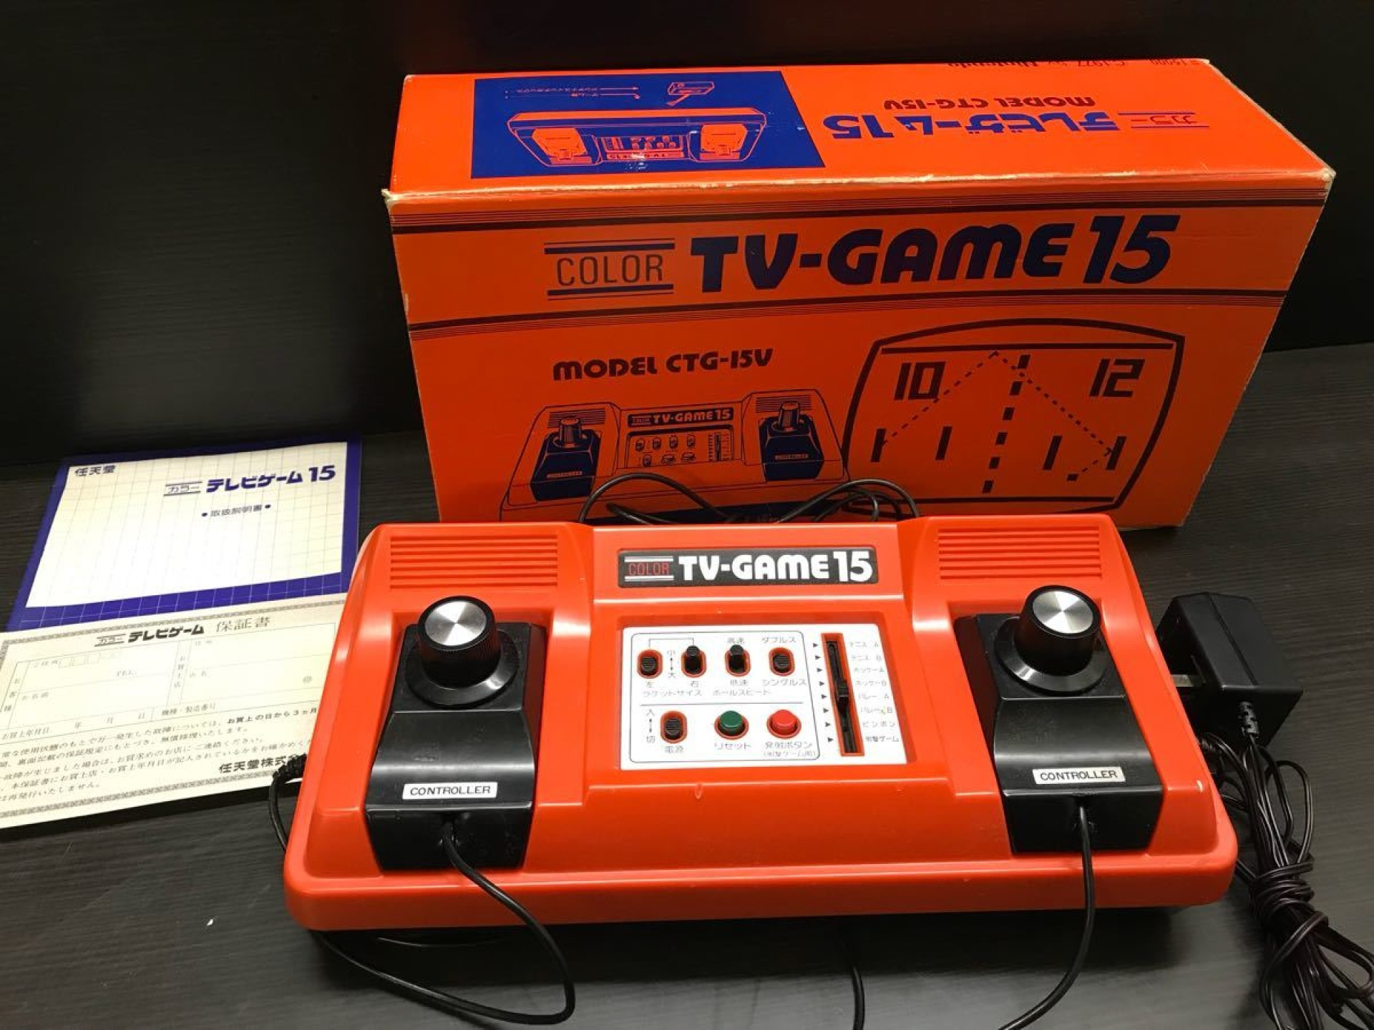
Atari
2600 1977
5200 1982
7800 1984
Lynx 1989
Jaguar 1993
Nintendo
Color TV-Game 1977
NES 1983
Super NES 1990
N64 1996
Gamecube 2001
Wii 2006
Wii U 2012
Switch 2017
PlayStation
PS1 1994
PS2 2004
PS3 2006
PS4 2013
PS5 2020

Slide 65
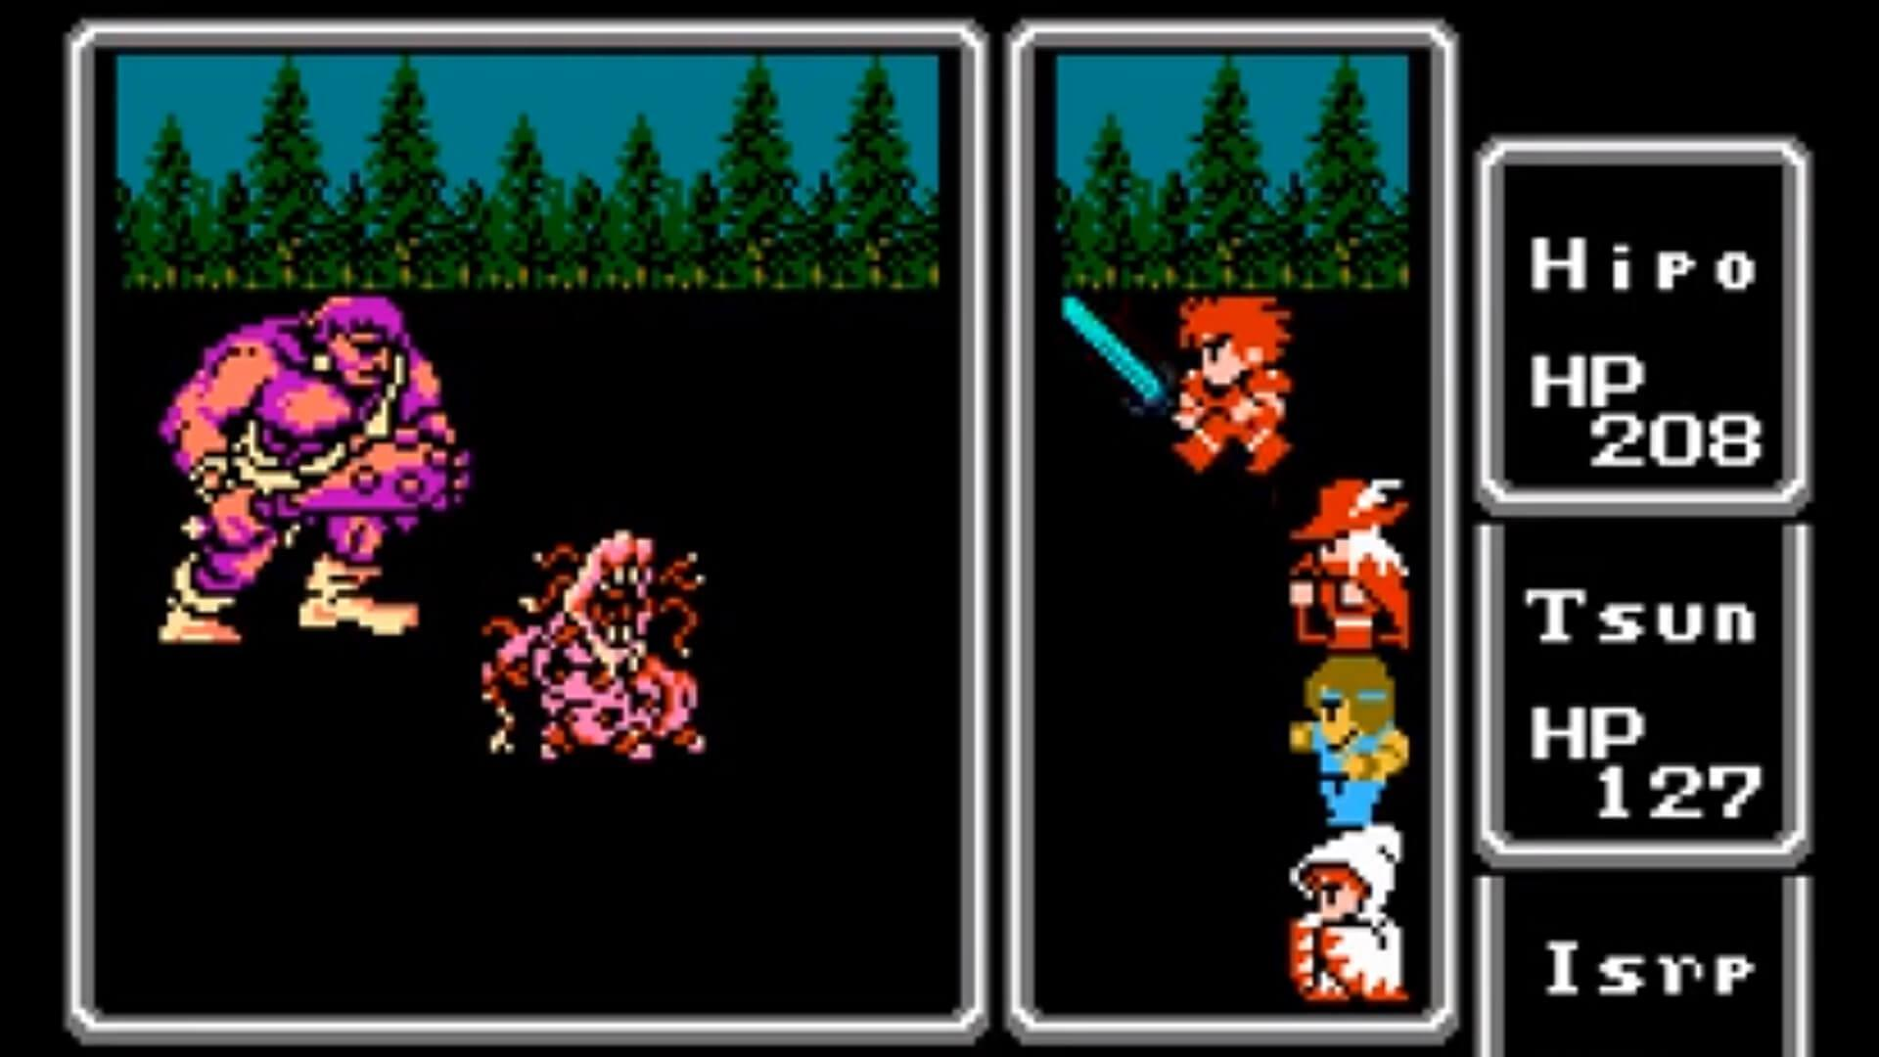
Assassin’s Creed Dates: Every 1 or 2 years since its inception in 2007
Final Fantasy Dates: Every 1, 2, or 3 years since its inception in 1987

Slide 66
Problems for the Digital Archaeologist:
Do we collect data on the digital artifacts in real-time? How much (and what) to collect?
Do we wait to see what the history of use is, and what people choose to remember/forget, and then conduct research?

Slide 67
(more) Problems for the Digital Archaeologist
Access to developers’ intellectual property (IP) and permission to publish.
Absence of corporate archiving (Lion’s Head Studios after Microsoft’s acquisition)
Absence of physical games media (modern consoles without CD/DVD/Blu-ray slots)
Reduction in access to working, legacy hardware

Slide 68
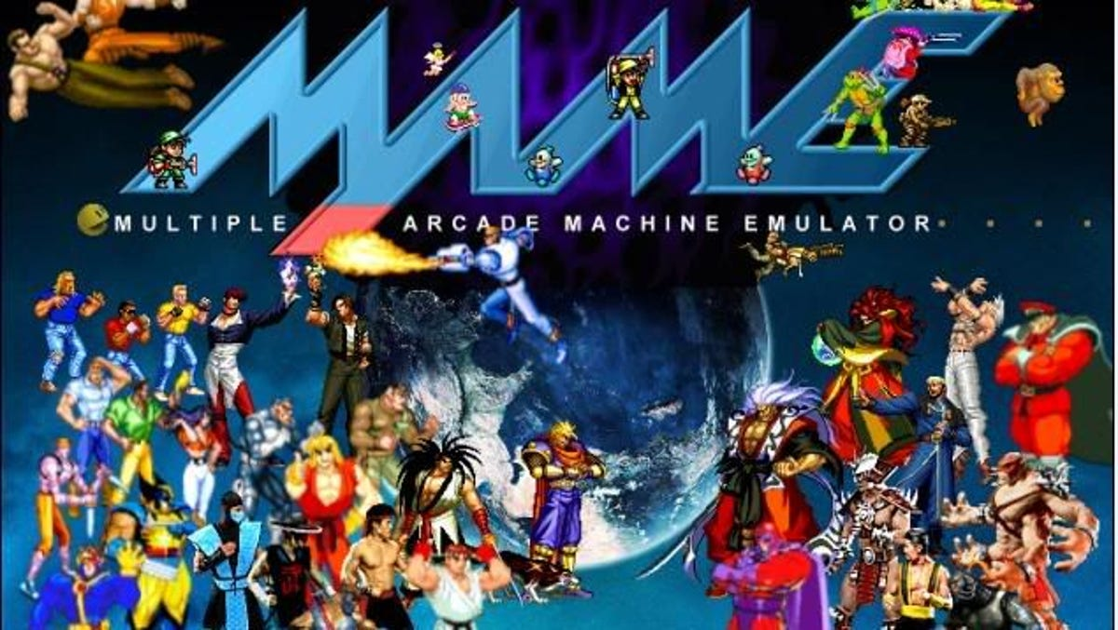
Internet Archive / MAME

Slide 69
We are witnessing in real-time the disappearance of our digital material culture.
Archaeology must adapt.

Slide 70
[This slide intentionally left blank]

